Slide 1


Team 48: Pocket Diagnostics
Bi-Weekly Update 1 Team members: Rohan Bharadwaj, Donavan Burrow, Jacob Newlin, Elijah Rodriguez Sponsor: Dr. John Lusher TA: Zian Wang
Notes:
Michelle

Slide 2
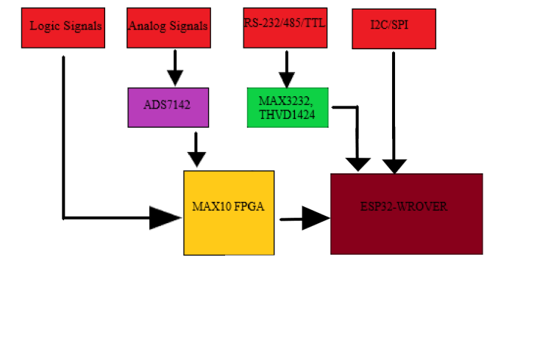
Project Summary
Problem statement:
Technicians in the electronics industry have evolved to servicing customers directly for consumer products, similarly to a plumber or electrician. Often they cannot bring or access bench devices and a suitable substitute is required to complete a job in a timely manner.
Function of the Pocket Diagnostics:
Provide a simple, man portable bench device that can evaluate low frequency electrical signals, I2C data signals, SPI data signals, Serial data signals and 16 channel logic signals for troubleshooting on devices that contain such data transfer methods.

Slide 3
Project/Subsystem Overview
Red - Elijah
Handles external ports and ESP32
Green - Rohan
Handles power and FPGA
Blue - Donavan
Handles UI and communication with ESP32
White - Jacob
Handles FPGA and ESP32 coding.
Data acquisition and communication
Data Processing and Power
Firmware
App Development
Notes:
Eric

Slide 4
Major Project Changes for 404
No changes in terms of team membership. The same ECEN 403 team has carried on over to ECEN 404.
Update hardware design to accommodate for integration of all subsystems.
Notes:
Eric

Slide 5
Project Timeline
Update and debug individual subsystems
Integrate App Development subsystem with Firmware subsystem.
January
February
February
March
Integrate Power and Data Processing subsystem with Data Acquisition and Communication Subsystem
Integrate electronic hardware subsystems with software subsystems
Notes:
Eric

Slide 6
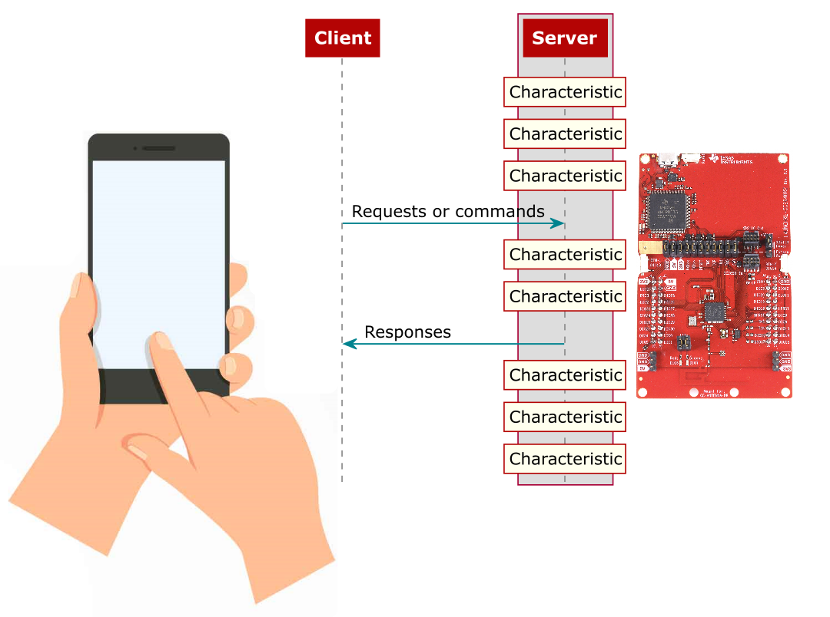
Firmware design
Jacob Newlin
Accomplishments since 403 10 hrs of effort | Ongoing progress/problems and plans until the next presentation
Reading data from UART, Receiving data from client, transferring data to client through read event. | Be able to indicate instead of reading data, fix SPI and I2C errors, begin creating more cases for client functions.

Slide 7
Data Processing and Power
Rohan Bharadwaj
Accomplishments since 403 6 hrs of effort | Ongoing progress/problems and plans until the next presentation
Reviewed current PCB design and made note of necessary changes. Updated circuit design for power supply to accommodate for the integrated subsystems. Updated PCB design to accommodate I2C communication between subsystems, as well as programming of FPGA. | Complete, validate, and order new PCB design.

Slide 8
Data Communication and Collection
Elijah Rodriguez
Accomplishments since 403 7 hrs of effort | Ongoing progress/problems and plans until the next presentation
Reviewed over my previous schematic and PCB design and noted where improvements can be made. Updated serial port sniffer schematic to make flashing code on the ESP32 smoother. Updated PCB design to accommodate for the new schematic design. | Complete and validate PCB design it can be ordered. Speak with Jacob and Rohan in regards of integration.

Slide 9
App Design
Donavan Burrow
Accomplishments since 403 6 hrs of effort | Ongoing progress/problems and plans until the next presentation
Sending/Receiving data via without crashing connection Changed how ESP32 to Phone communication | Fixing data reception to take in all data, instead of only the last line of data Correct UI elements as functionality for data types is implemented

Slide 10
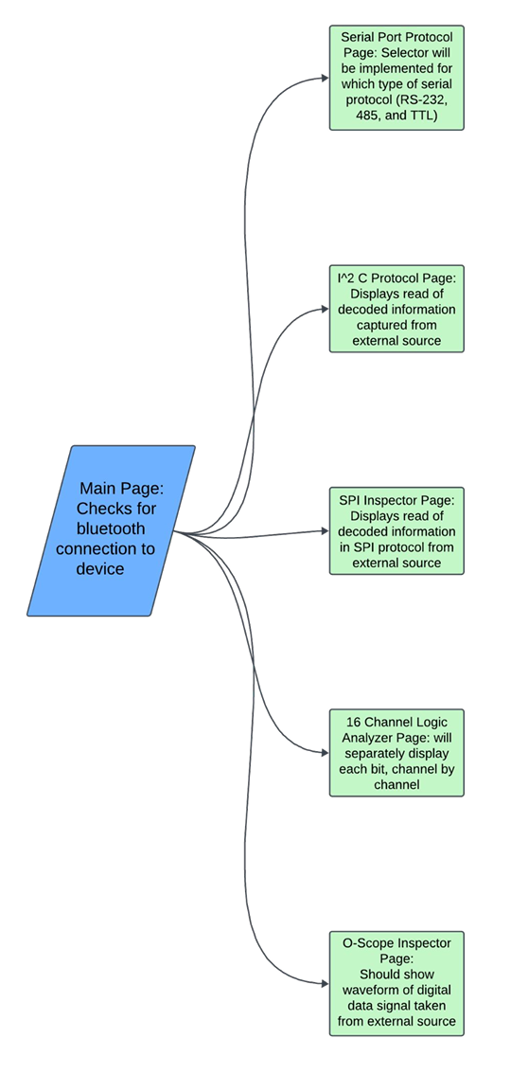
App Subsystem

Slide 11
Parts Ordering Status
Updated PCBs and accommodated parts still need to be ordered.
Goal is to have all parts received by second update presentation.
Notes:
Michelle

Slide 12
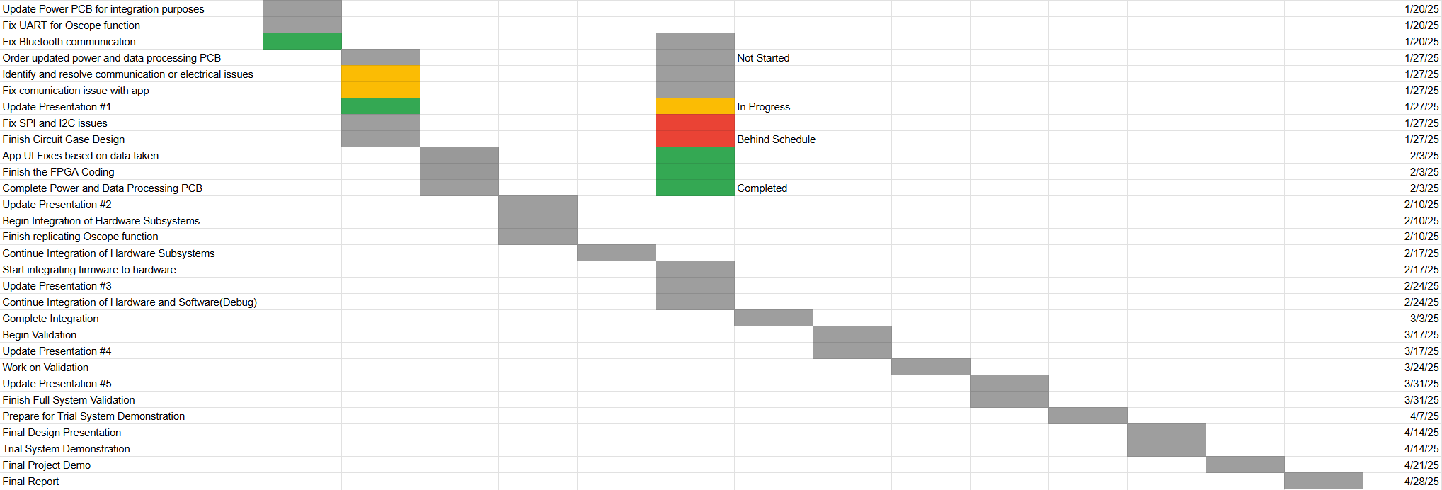
Execution Plan
Notes:
Michelle

Slide 13
Validation Plan
Paragraph # | Test Name | Success Criteria | Data | Status | Pass/Fail | Responsible Party
3.2.1.1 | Multi-Protocol Communication | Perform multi-protocol I. communication.1 MHz clock rate |  | UNTESTED |  | Rohan Bharadwaj, Elijah Rodriguez
3.2.1.2 | Data Acquisition for Low-Frequency Signals | Support data acquisition for low-frequency signals (up to 100 kHz) |  | UNTESTED |  | Rohan Bharadwaj, Elijah Rodriguez
3.2.1.3 | Logic Analysis | Capture and analyze signals with a sampling rate of up to 50 MS/s |  | UNTESTED |  | Rohan Bharadwaj
3.2.2.4 | Battery Life | 8 hours |  | UNTESTED |  | Rohan Bharadwaj
3.2.3.1.1 | Power Consumption | Maximum peak power should not exceed 4.5W |  | UNTESTED |  | Rohan Bharadwaj
3.2.3.1.2 | Input Voltage Level | 3.3-3.7V |  | UNTESTED |  | Rohan Bharadwaj
4.3.1.1 | Power Distribution Validation | MAX3232 and THVD1451 receive 3.3V from the ESP32 |  | UNTESTED |  | Elijah Rodriguez
4.3.2.1 | MAX3232 and THVD1451 Level Shifting Verification | Voltage levels to 3.3V for the MAX3232 and THVD1451 |  | UNTESTED |  | Elijah Rodriguez
4.3.3.1 | RealTerm Communication Validation | Ensure transmitted and received data match the RealTerm program |  | UNTESTED |  | Elijah Rodriguez
4.3.4.1 | Signal Integrity Validation | Stable signal waveforms for RS protocols |  | UNTESTED |  | Elijah Rodriguez
Notes:
Michelle

Slide 14
Validation Plan
Paragraph # | Test Name | Success Criteria | Data | Status | Pass/Fail | Responsible Party
5.2.1 | Bluetooth Connection Event | Connection event displayed on app for phone and ESP32 |  | UNTESTED |  | Donavan Burrow, Jacob Newlin
5.2.2 | Bluetooth Communication | Perform bluetooth communication with each data type send/receive |  | UNTESTED |  | Donavan Burrow, Jacob Newlin
5.2.3 | Multi-data acquisition and display | Phone displays correct data on graph for each data type |  | UNTESTED |  | Donavan Burrow

Slide 15
Thank You

